Slide 1

National Pirogov Memorial Medical University
Microbiology Department
Infectious Immunology
elective course
01

Slide 2
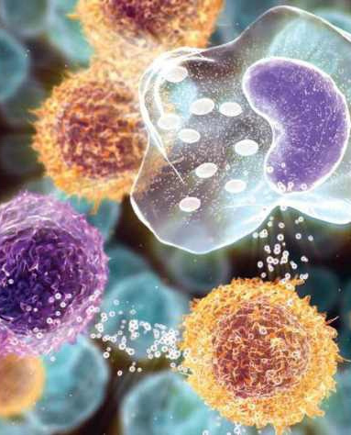
Infectious immunology studies the mechanisms of non-specific and specific protection of the organism in infectious diseases;
It gives the foundation for the development of methods of diagnosis, prevention, treatment of infectious diseases, as well as methods of assessing the immune status of a person.

Slide 3
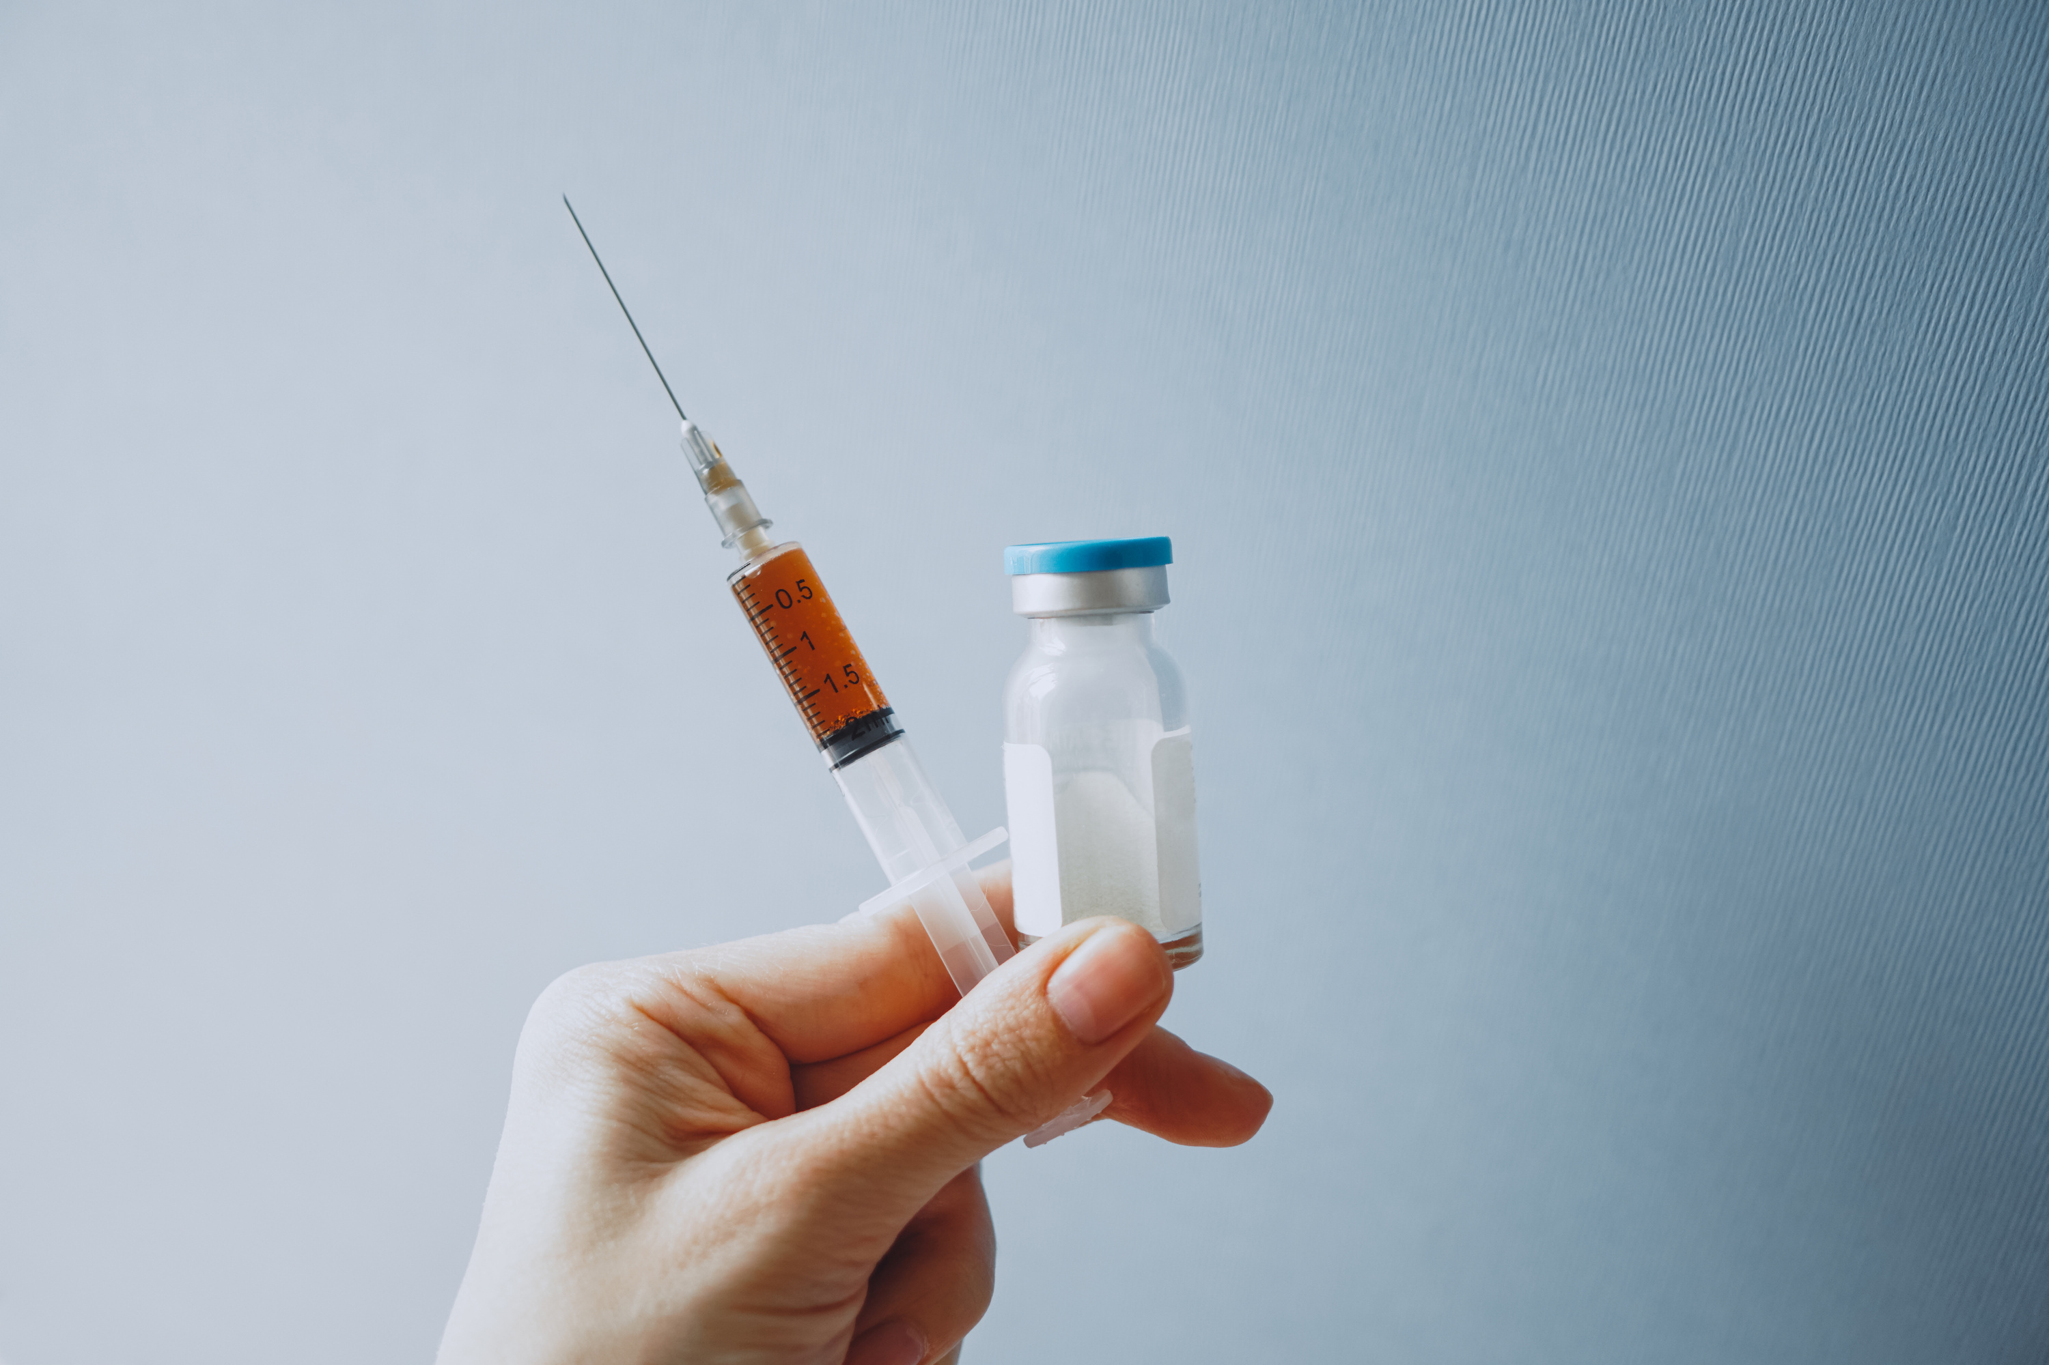

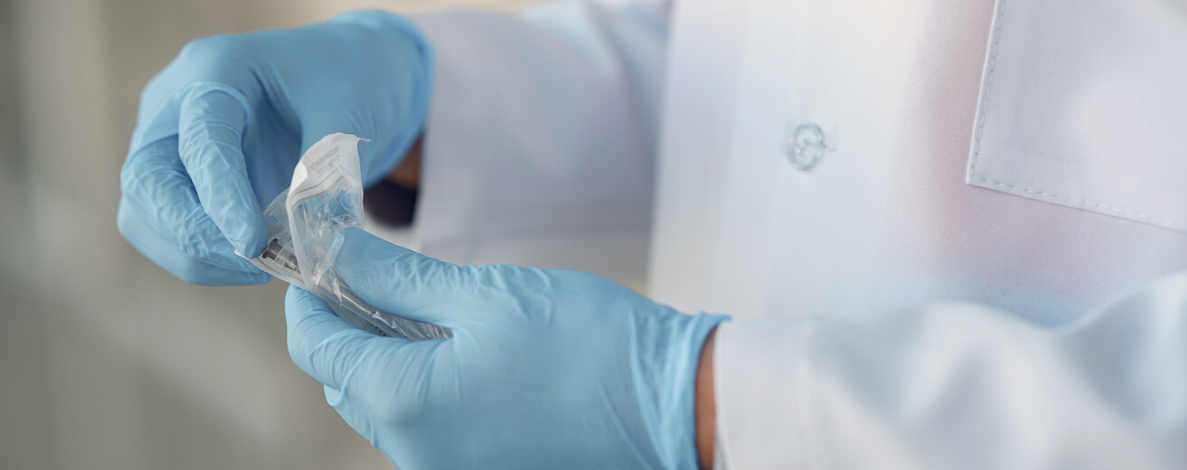
  Students can attain complete, deep, and meticulous knowledge of Infectious Immunology at the Microbiology Department.
  Exactly here previously obtained information is accumulated, systematized, analyzed and realized by future health professionals.

Slide 4
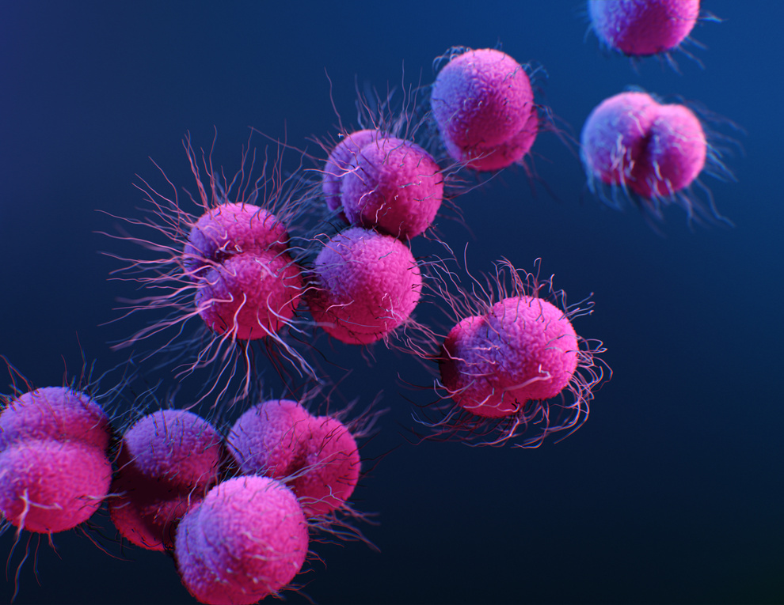
The main tasks of discipline are:
Formation and application of fundamental knowledge of the development of the immune response at acute, and chronic infectious diseases, purulent-inflammatory processes, caused by pathogenic
and opportunistic pathogen.
The aim of the course is to gain and
develop deep knowledge of the basic mechanisms of antiviral, antibacterial, antitoxic, antifungal, and antiprotozoal immunity formation.
05

Slide 5
Applicants of high education study and realize:
The elements of the killing system of the human body: natural killers, large granular lymphocytes, K-cells, LAC - cells, and their significant role in immunological surveillance.
Stages of the immune response: recognition, antigen processing, presentation of Th1 antigen to lymphocytes
• Proliferation and differentiation of T cells (helpers, suppressors, delayed-type hypersensitivity effectors, memory cells)
Cytokines, their role in formation
immune reactions.
• Interleukins, their significance.
Applicants for higher education will acquire an deep insight on the topics specified above.
13

Slide 6


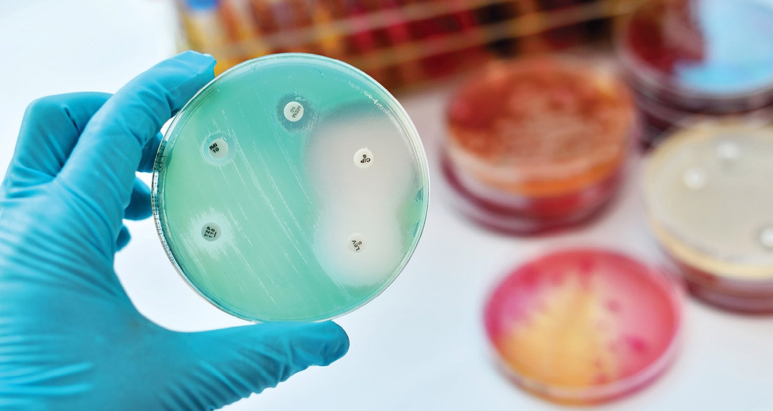
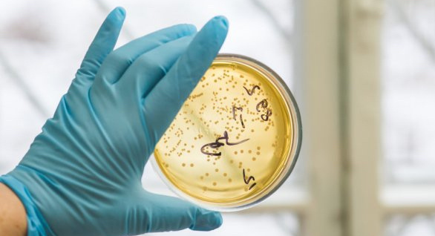
The elective course "Infectious Immunology", which is recommended for study by all applicants of higher medical education, as well as those who seek to
➢deepen their knowledge regarding the basics of infectious pathology,
➢use the acquired knowledge, practical skills in the field of medicine for research against infection protection in
● treatment,
● diagnostics,
● prevention of infectious diseases, and purulent-inflammatory processes.

