Slide 1

Elective course
National Pirogov Memorial Medical University, Vinnytsya
Department of Microbiology
Immunobiological preparations

Slide 2

- Do you begin to think or necessary vaccination?
- Are all vaccines safe?
- How to control quality of vaccines?
- How is a vaccination conducted in Ukraine? - What preparations do attribute to immunobiological?
- Are eubiotics really good for the human body?
If you are interested in such questions, we invite you to attend a course of your choice
“Immunobiological preparations”

Slide 3
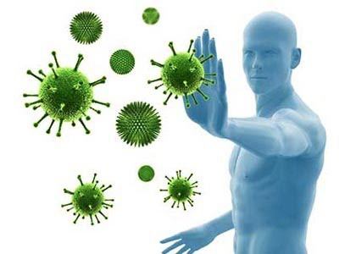
ANNOTATION OF COURSE:
The course is a part of educational program which allow you to deepen your knowledge about herd immunity, the ways to control infectious disease, and medical preparations which are used to influence on human immune system. A participants will acquaint with main groups of immunobiological preparations which are licensed in Ukraine; get understanding of pattern and mechanisms of post-vaccination immunity formation; will inform about stages of immunobiological medicines production and control of their safety, effectiveness, etc.

Slide 4
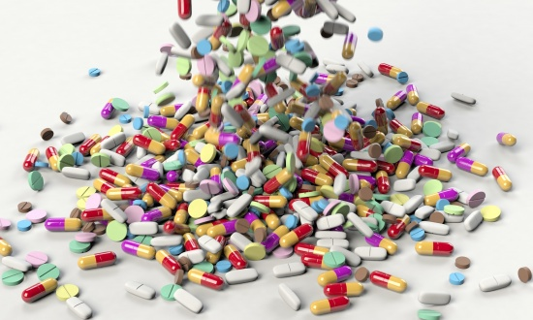
Range of immunolobiological preparation studied at course:
Vaccines
and that's not all you can learn in this course)
Immune sera
Probiotics
Immunomodulators

Slide 5
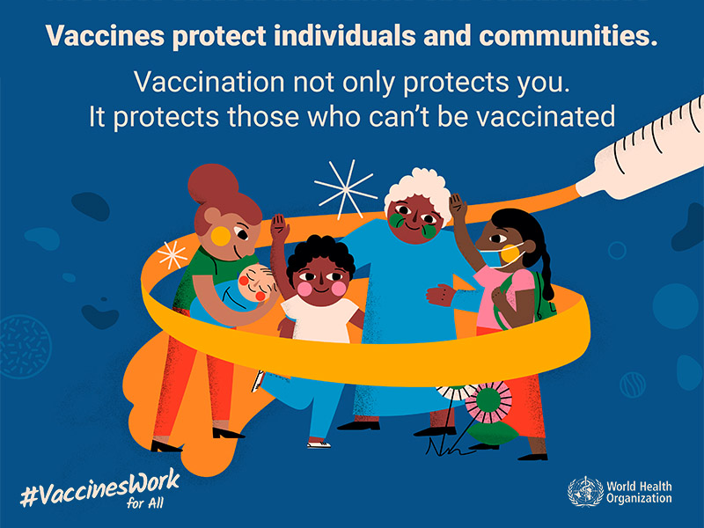
Aim of course
To deepen the student's knowledge of infectious protection by creating herd immunity.
To get enough knowledge and abilities for effective influence on human immune system with immunobiological medicines according to purpose and indications for such influence.

Slide 6
Main goals of discipline :
To understand the basic mechanisms of immune response formation by human body under different setting.
To know main groups of immunobiological preparations, features of their use in medical practice, main indications and contraindications to their use.

Slide 7
Main goals of discipline :
- To become qualified in timetable vaccination for interactions with healthcare services, parents, and medical staff in professional activity;
- To know the algorithm of action in case of vaccination term violation in children for successful postvacinal immunity;
- To know possible side effects at therapy with immunomodulaters.

Slide 8
Main goals of discipline :
To be good in medicinal correction at dysbiosis which may arise because of antibacterial therapy.
To get a concept about probiotics, their classification, composition, features of their use
To become acquainted with basic achievements in modern biotechnology industry and different ways which are used for immunobiological preparations production.

Slide 9
We are waiting for you!!!!

