Slide 1


"Modern treatment and prevention strategies for virus-associated pandemics"
National Pirogov Memorial Medical University,
Vinnytsya
Department of Infection Diseases
Prepared by: Tetiana Melnyk,
assistant of infectious diseases department

Slide 2
Actuality:
There were 37.9 million [32.7 million–44.0 million] people living with HIV by the beginning of 2019.
In 2018, 79% [67–92%] of people living with HIV knew their status.
Among people who knew their status, 78% [69–82%] were accessing treatment.
And among people accessing treatment, 86% [72–92%] were virally suppressed.
Of all people living with HIV, 79% [67-92%] knew their status, 62% [47-74%] were accessing treatment and only 53% [43-63%] were virally suppressed at the end of 2018.
You are asking: What is the reason of prescribing antiretroviral therapy (ART) for all people living with HIV?
We are answering: Effective ART will make impossible further spreading of HIV-infection among HIV-negative people and as a result will influence on speed of HIV epidemic development in each country and around the world!
A range of effective preventive strategies are directed against getting HIV by healthy people besides effective antiretroviral therapy (ART which has also a name – “treatment as prevention – TasP”). Such medication prevention strategies influence on HIV spreading as well:
Pre exposure prevention - PrEP
Post exposure prevention - PEP
Mother to child transmission prevention - MtoCh
https://www.unaids.org/en/resources/fact-sheet

Slide 3
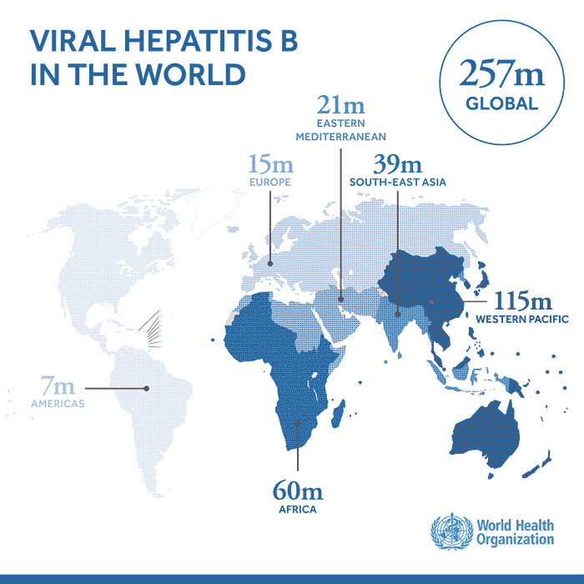
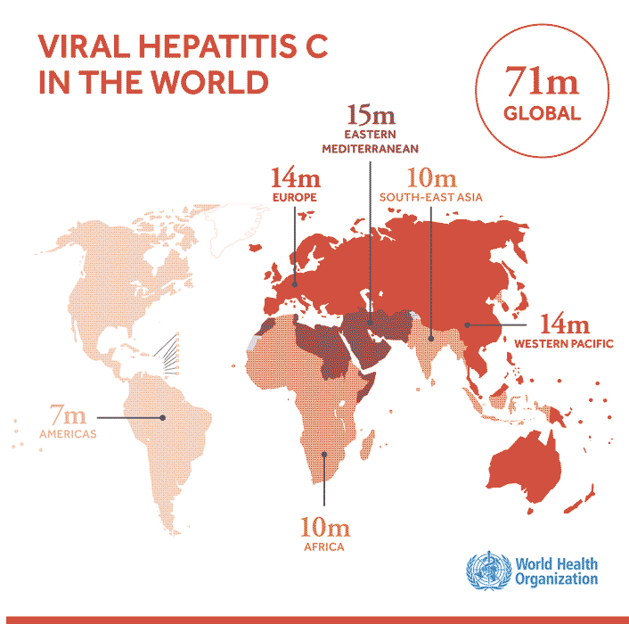
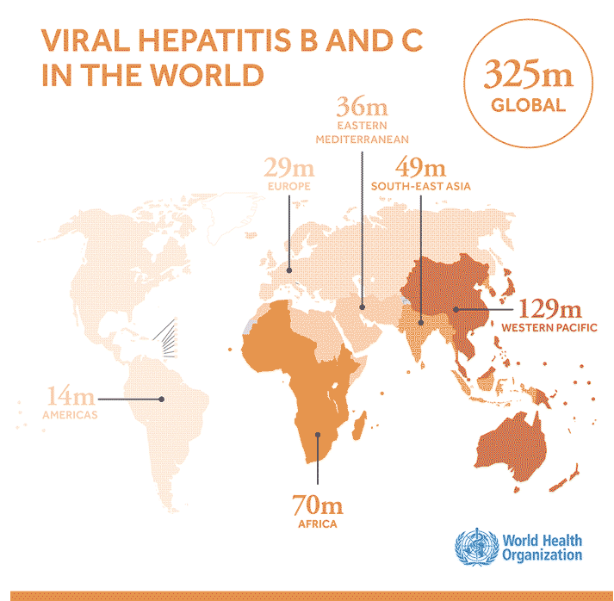
Асtuality: viral hepatitis В and С

Slide 4
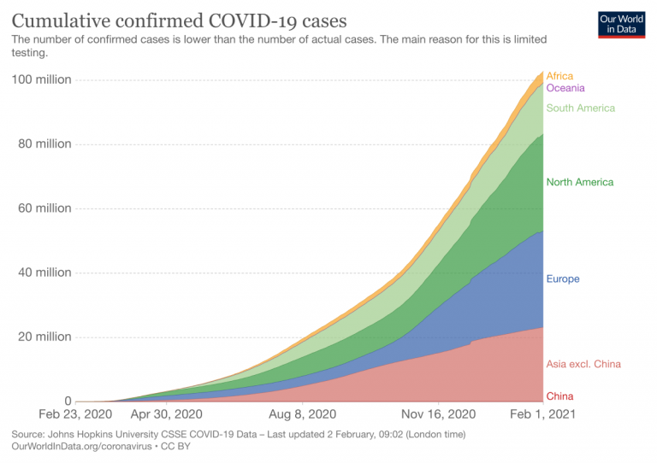
Actuality: COVID-19
Mechanisms of active spreading of COVID-19
Varieties of different strains and their features
Specific prevention and chemoprophylaxis of coronavirus infection
Etiotropic drugs and its mechanisms of action

Slide 5





Types of actual treatment and medication prevention of HIV-infection
Antiretroviral therapy (АРТ), named also «treatment as prevention» (TasP) – treatment for HIV-positive will be prevention of HIV transmission to their HIV-negative partners
Mother to child transmission prevention (MtoCh)
Pre exposure prevention (PrEP)
Post exposure prevention (PEP)

Slide 6
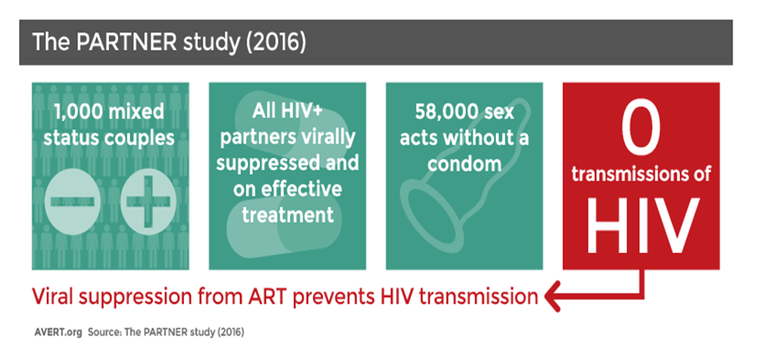

Subject: «HIV-infection: antiretroviral therapy, actual treatment and prevention strategies»
TOPIC: HIV-infection – early and in time diagnostic of HIV; prescribing, monitoring and correction of antiretroviral therapy and applying of actual prevention strategies, directed on prevention of HIV, HCV, HBV, COVID-19 spreading on individual as well on population level.
GROUNDING (background): ART and HIV medication prevention methods are only accessible and affective methods on the way of HIV epidemic stopping. The prevalence of viral hepatitis is increasing and COVID-19 pandemic reduced medical service delivery to patients with viral hepatitis.

Slide 7

Objectives:
To study the proposed material of the proposed subject «Modern treatment and prevention strategies for virus-associated pandemics».
Specifically:
Forming pf practical skills among 5th year students directed on in time HIV, viral hepatitits, COVID-19 diagnostics, prescription, monitoring of antiretroviral therapy, directly acting antiviral HCV therapy, COVID-19 effectiveness, management of side effects and therapies failure.
Studying of actual prevention strategies medication and non medication prevention of HIV-infection, chronic viral hepatitis, COVID-19 and forming applying of practical skills.

Slide 8
- To get information about in time screening and HIV-infection verification.
- To get familiar with antiretroviral medication classes, mechanisms of its action and with principles of combination.
- To be able to perform ART monitoring, to indicate ART side effects and to get familiar with methods of the side effects correction.
- To discuss and to consider questions of ART effectiveness and ART failure, method of its monitoring and correction.
-To get familiar with types of the actual medication prevention of HIV-infection and features of its prescription (Mother to child transmission prevention, Pre exposure prevention, Post exposure prevention).
- To get familiar with the antiviral therapy combinations for viral hepatitis B and C and its control.
- To be able manage viral hepatitis failure.
- TO know main approaches for pathogenic and symptomatic therapy of COVID-19.
Subject’s targets:

Slide 9
Program of the subject:
Module1:
1. Epidemiological futures of HIV-infection in Ukraine and around the world
2. Medical observation of HIV-positive patients, lifetime observation. Clinical classification of HIV infection. Health condition evaluation of people living with HIV at the time of diagnosis verification and thereafter (clinical, laboratory and instrumental monitoring). Principles of diagnosis, treatment and prevention of opportunistic diseases.
3. Classes of antiretroviral drugs, mechanisms of action and principles of ART combination. The indications for ART prescription: approach “U=U” – “Undetectable = Untransmittable”. The choice of the first line antiretroviral therapy combination, the ART effectiveness concept, adverse reactions and its monitoring methods. Adherence to therapy. The first ART combinations in the international clinical protocols (EACS, IAS, DHHS).
4. First line ART failure, second line ART combinations. Treatment adherence. Drug-drug interaction (DDI) with antiretroviral medications, monitoring and management. New antiretroviral drugs and their place in current ART protocols. “ART optimization” (switching) in virally suppressed patients. Features of ART prescription in different patients groups.
5. HIV prevention strategies. Types of ARV medications’ prophylaxis. Pre-exposure prophylaxis (PrEP), post-exposure prophylaxis (PEP). Mother to child HIV transmission prevention: management of HIV-positive pregnant women and babies born from HIV-positive mothers.
Module2:
6. Diagnostic and verification of viral hepatitis B and C.
7. Antiviral therapy regimens, prescribing, monitoring, adverse reactions and methods of their correction.
8. COVID-19. Epidemiological features. Etiology of the disease. Varieties of virus strains and their distribution. Correlation of virus strain and clinical course. Features of the disease in patients with diabetes, hypertension, alimentary-constitutional obesity. Approaches to pathogenetic treatment.
9. Specific and nonspecific prevention of coronavirus infection. Vaccination against COVID-19. Types of vaccines and mechanisms of action. Booster and additional dose. Use of monoclonal antibodies (bamlanivimab and etesevimab) and antivirals (remdesevir, molnupiravir, favipivir, paxlovid) in the treatment of coronavirus infection at the outpatient and inpatient levels.

Slide 10


Forms and methods of study:
Demonstrational methods:
Patients demonstration, multimedia shows, tables and graphs illustrations, video demonstrations.
Practical methods: working out of practical skills (reweaving of clinical cases, clinical situations modeling accordingly with the subject objectives and targets) with applying of a discussion, small groups work, brain storming.
Methodological suplementation:
Video, multimedia shows, PP slides are being used.
Control methods:
Clinical cases solving;
Assessment of theoretical and practical knowledge, ability to prescribe and monitor ART, ability to apply of prevention strategies;
Interview (quiz).

Slide 11
Study results:
The student must know :
Indications and order of performing screening and verification of HIV-infection;
Classes of antiretroviral drugs;
Mechanism of action of antiretroviral drugs;
Principles of ART combinations;
ART combinations accordingly with international protocols (EACS, IAS, DHHS);
Side effects which can occur during antiretroviral therapy providing and methods of their corrections;
Interaction features of antiretroviral drugs with other medications;
Types of the actual medication prevention of HIV-infection and features of its prescription (Mother to child transmission prevention,
Pre exposure prevention, Post exposure prevention).
The main classes of antiviral drugs of direct action against HCV. Mechanisms of their action. Principles of combination of these drugs. Schemes of antiviral therapy for viral hepatitis.
Indications for the antiviral drugs prescriptions in patients with viral hepatitis. Side effects of these drugs. Types of modern drug prevention of viral hepatitis. Vaccination against HBV.
Preventive and anti-epidemic strategies are simple COVID-19. Approaches to specific prevention. Vaccination, types of vaccines, types of additional and booster doses. Use of monoclonal antibodies and antivirals.

Slide 12
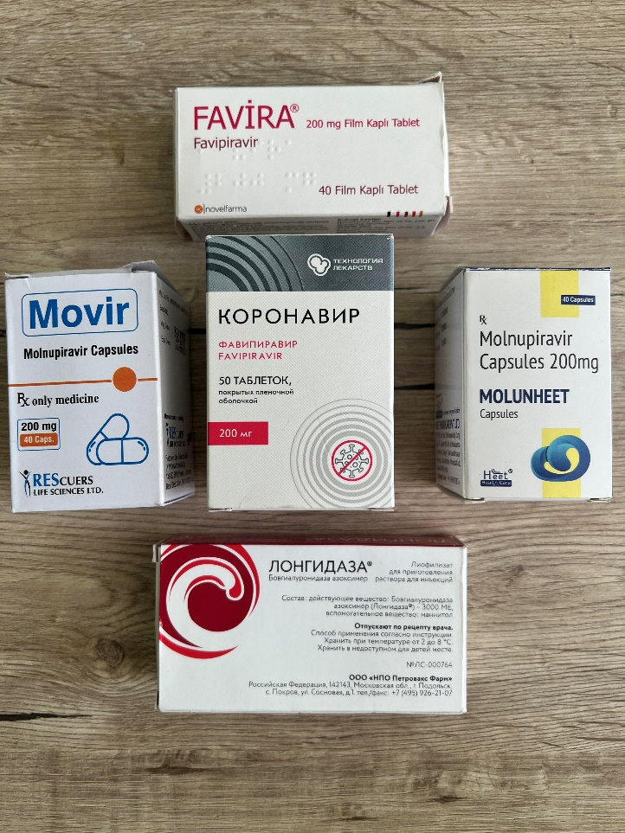
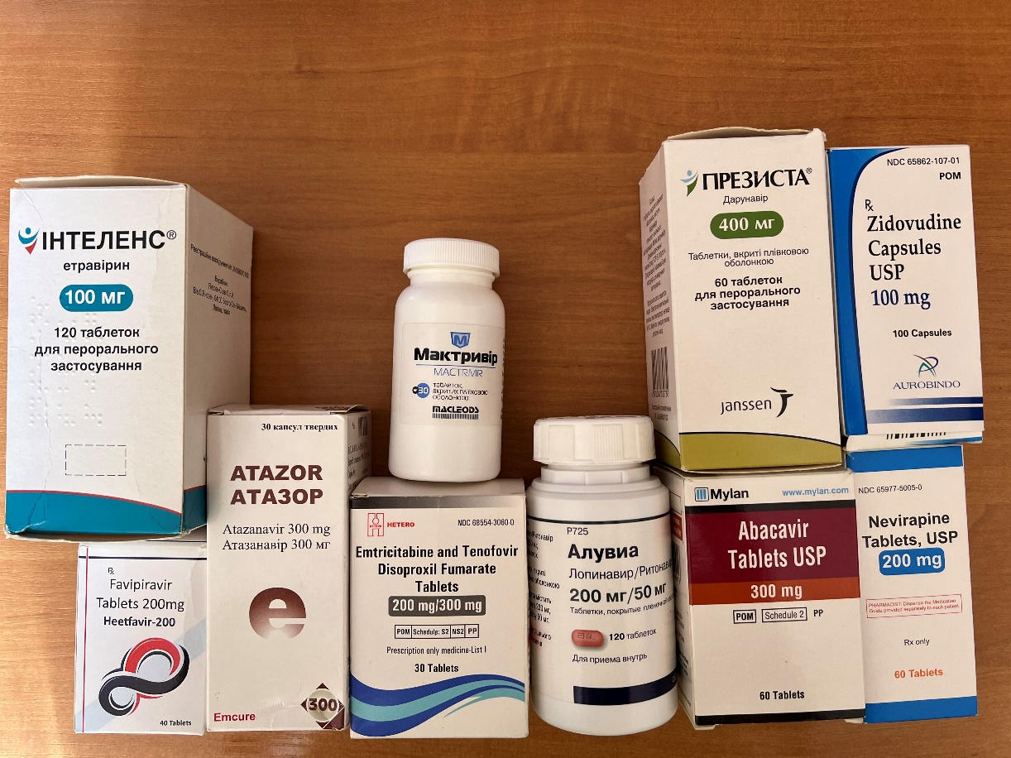
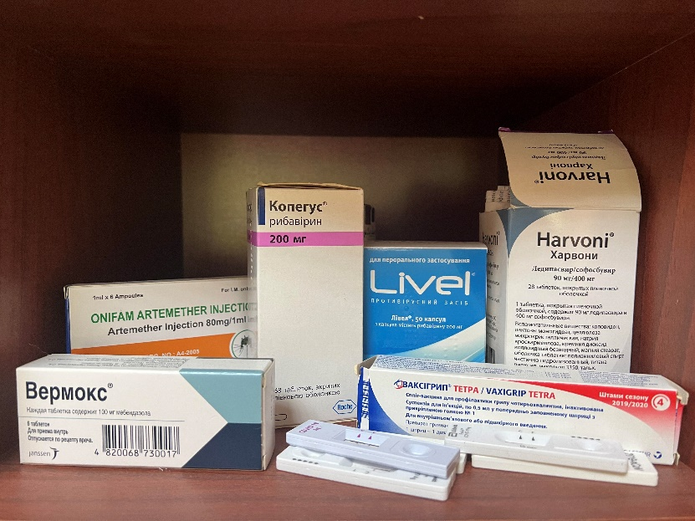
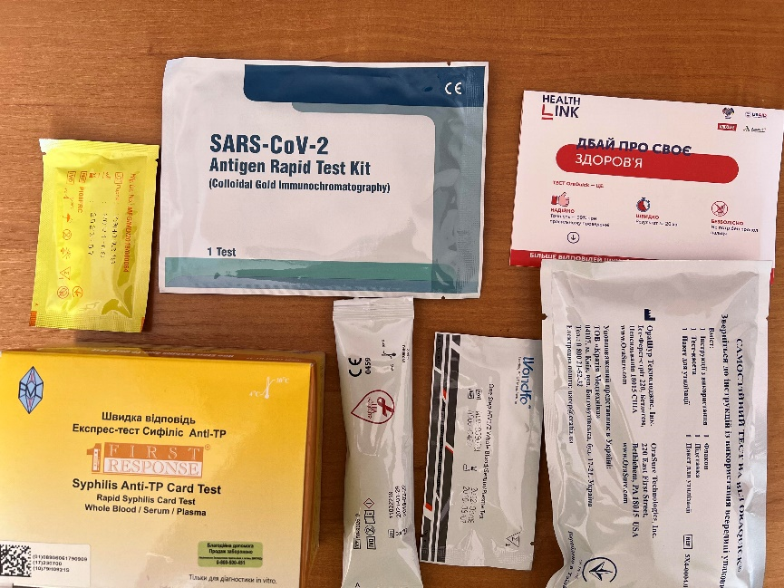
What can you do and see in class?
Different types of ART therapy, drugs for the treatment of viral hepatitis and coronavirus infection.
Different types of rapid tests for HIV, HCV, COVID-19. Perform tests.
Communicate with thematic patients.

Slide 13
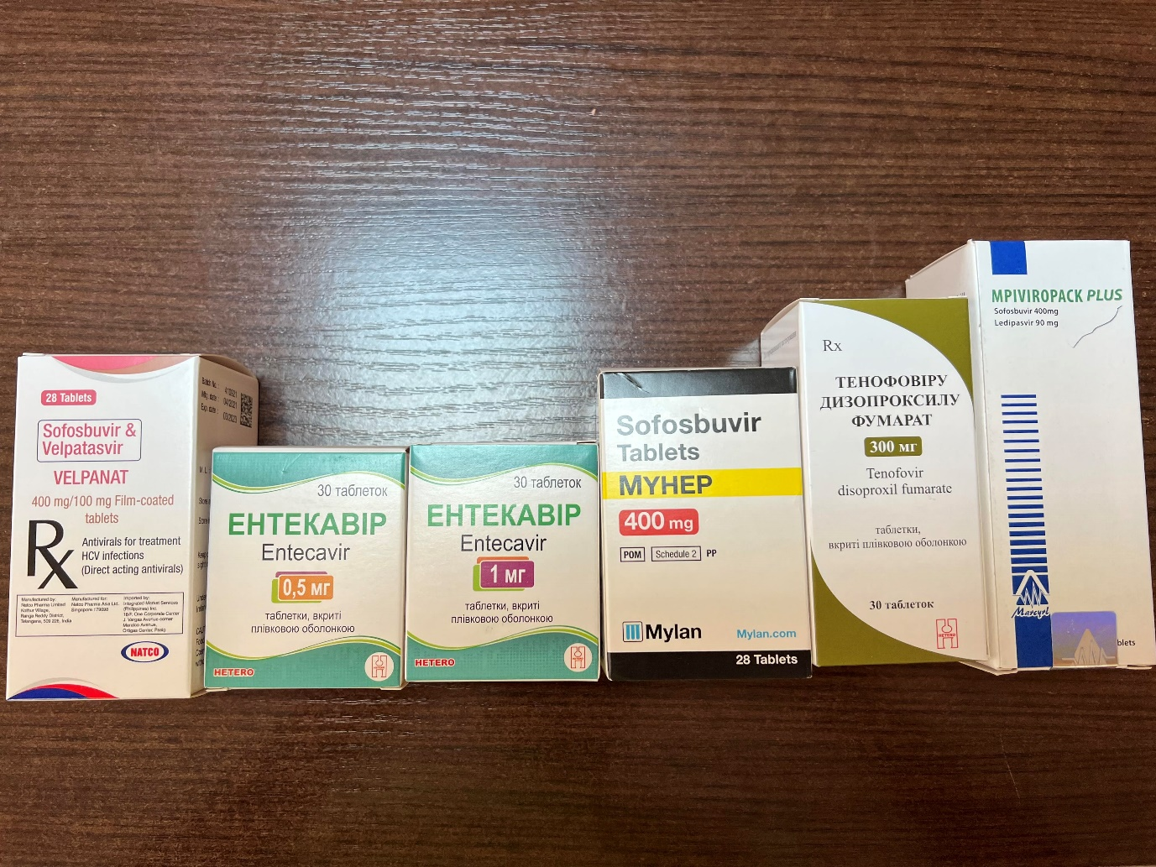
What can you do and see in class?
Get tested for HIV.
Get acquainted with the documentation and learn how to fill it out.
Make a vaccine against hepatitis B virus.

Slide 14


Slide 15
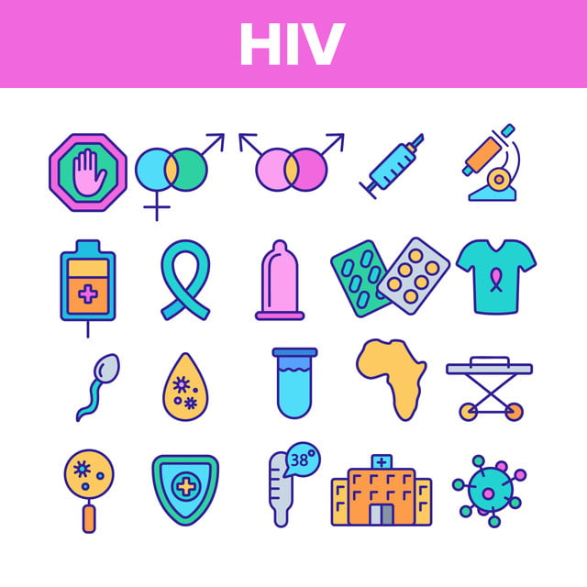

Slide 16
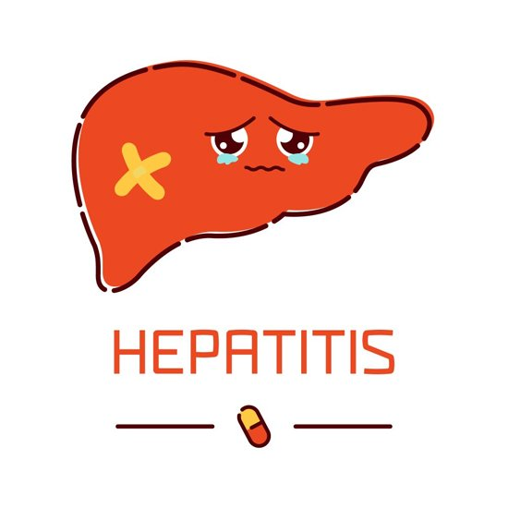

Slide 17

Thank you for attention!
Stay healthy!

